Slide 1
Introduction to W3C Web of Things
Michael McCool
Taipei, OCF AGM, 10 Nov 2016

Slide 2

W3C and the Web of Things – resources and links
W3C: World Wide Web Consortium: https://www.w3.org
Web of Things Interest Group: https://www.w3.org/WoT/IG/
Charter: Leverage web standards and technology to enable IoT applications
Web architecture: https://www.w3.org/standards/webarch/
Proposal to charter a Working Group in the W3C to develop standards for WoT:
https://www.w3.org/2016/09/wot-wg-charter.html
Proposed co-chairs: Matthias Kovatsch (Siemens), Kazuo Kajimoto (Panasonic), Michael McCool (Intel)
White paper on WoT architecture: http://w3c.github.io/wot/charters/wot-white-paper-2016.html
WoT current practices: http://w3c.github.io/wot/current-practices/wot-practices.html

Slide 3
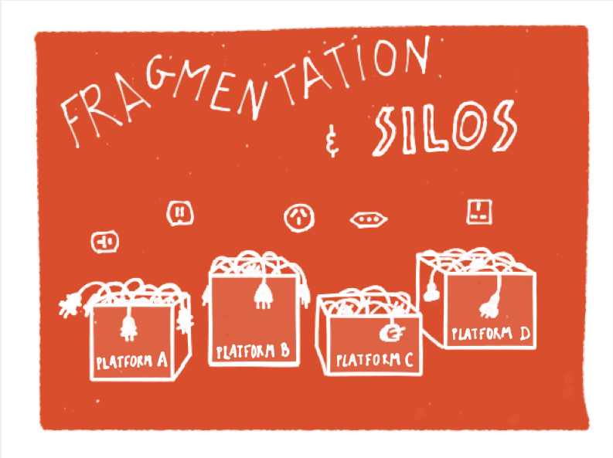
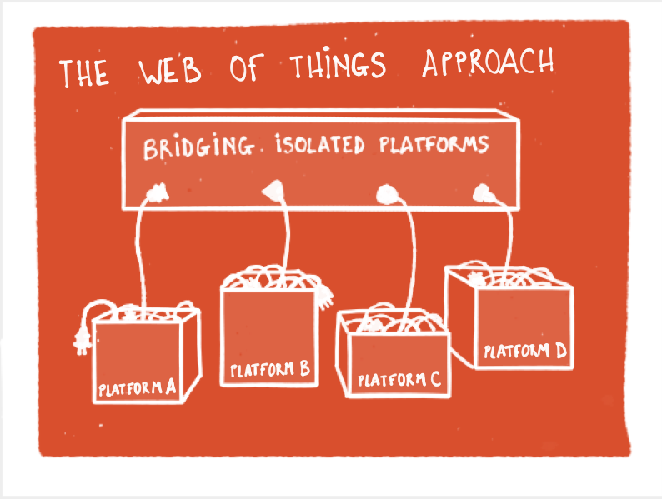
Goal: enabling interoperability across platforms
spanning isolated platforms
Rather than defining a new platform → focus on metadata and spanning existing standards
Notes:
Proliferation of IoT platforms, standards and technologies
Leading to fragmentation, and silos for product & data
Web as interoperability layer
Counter fragmentation
Reduce complexity & costs
Increase market size
Web of Things
Simplified app development
Uniform approach to semantics and metadata

Slide 4
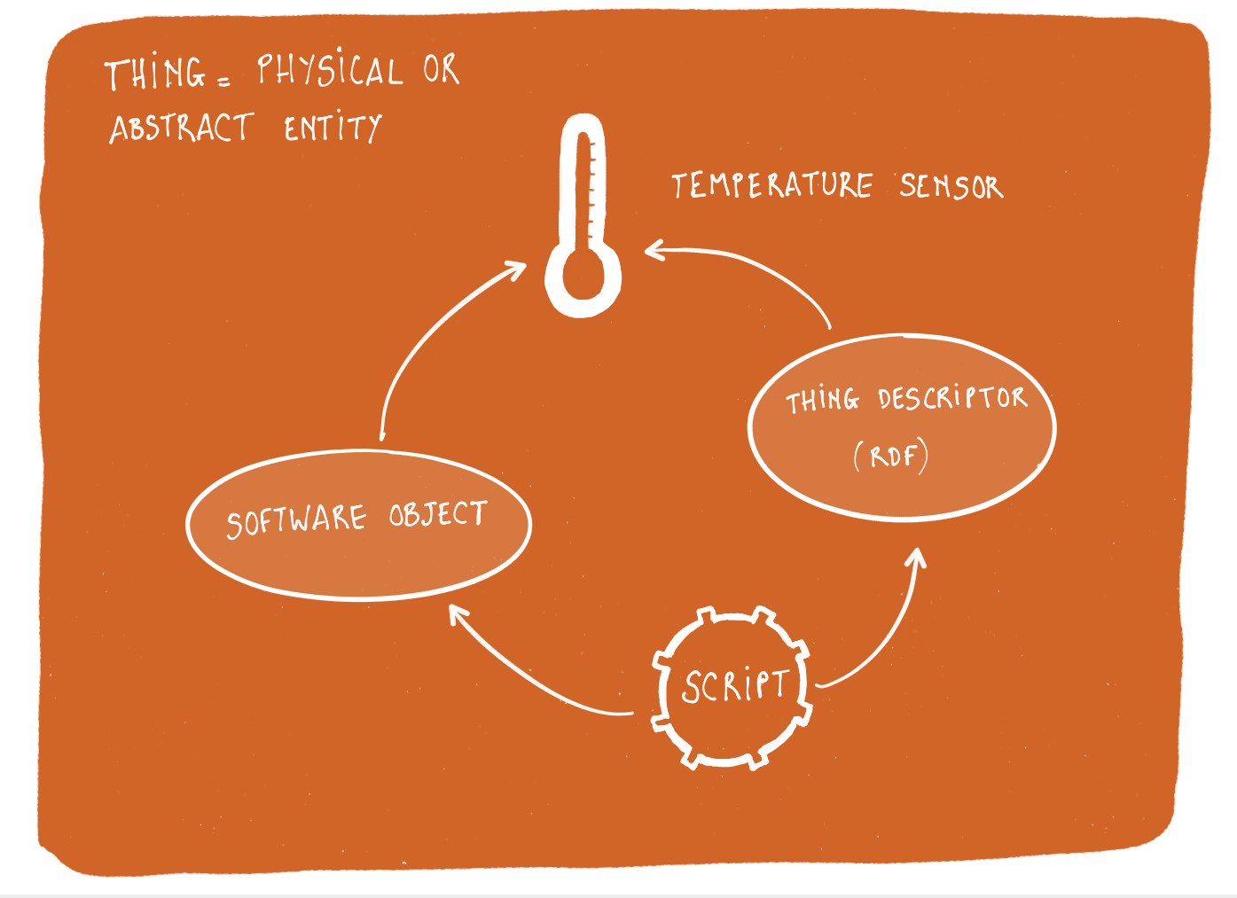
Thing abstraction
Applications act on “Things”
Things are software objects
Digital avatars representing physical or abstract entities
Have properties, support actions and events
Can be local or remote
Rich metadata descriptions for every “Thing”
Each Thing has a URI for its name
URI provides access to its description
Ontologies describe “things” and their relationships
Using W3C’s Linked Data semantic framework
Notes:
Local things for the sensors and actuators connected to that device. Software objects for controlling remote things for distributed control.
You could mention the role of object histories – where has it been, what has happened to it, etc.

Slide 5
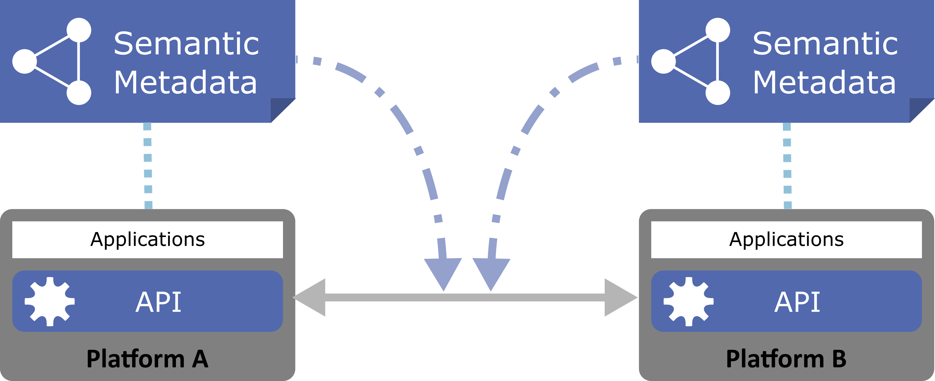
Benefits of standardised metadata
Metadata simplifies application development
Decouples underlying protocols
Enables automated tooling
Metadata enables interoperability
Describe the interfaces exposed to applications
Describe the communication and security requirements for accessing things
Describe the data models, semantics, and domain constraints

Slide 6
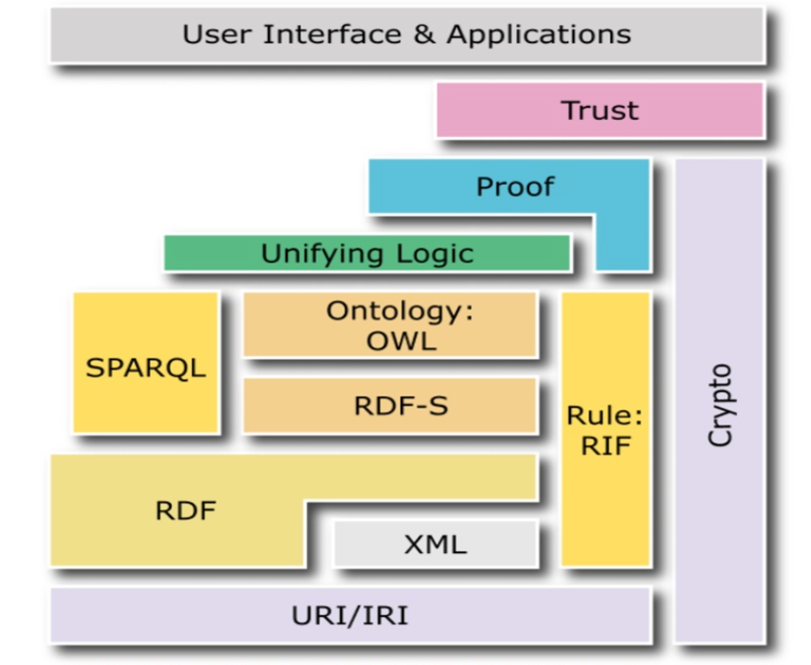
Linked Data and semantic models
Well-defined semantics ensure that platforms share the same meaning for the data they exchange
→ Discovery based upon properties and relationships
Search engines that can index the Web of Things
→ Verify that a thing is consistent with given models
→ Design service compositions based upon knowledge of which services are compatible
→ Reuse existing domain knowledge (eg schema.org)
RDF = semantic network with nodes connected by labelled arcs
W3C has a rich suite of related standards
Notes:
Note that figure is out of date… mention JSON-LD, etc.

Slide 7
Web of Things – current reference architecture
WoT Servient
Things can simultaneously be both clients and servers
“Servients”
Use plugin “connectors” to specific protocols
Can be different protocols on different connectors
Proposed WG deliverables to include
Thing Description (TD) metadata format
Language-independent API
Protocol binding
Map from abstract “interaction model” to concrete protocol
Security management
App Script
Discovery API
Client API
Server API
Runtime Environment
Resource Model
Thing
Description
Protocol Bindings
Client Role
Server Role
WoT Interface
Web Server
Web Client
WoT Servient
WoT Servient

Slide 8
Relationship of W3C WoT to OCF
W3C can provide community-based…
Uniform Thing Description for all ecosystems
Explicit support for IoT services and devices
But still support web service ecosystem
In contrast with RAML/Swagger:
Only designed for server-based web services
Connect existing Web community to the IoT
Semantic web (RDF, schema.org, …)
Browsers
Search engines
Web services
W3C WoT
OCF
Amazon
Web
Services
DDS
HomeKit

Slide 9
Summary
W3C WoT WG to target applying web technologies to the Internet of Things
Develop “Web of Things” standards
Based on several years of work in the W3C WoT Interest Group
Aiming at an abstraction layer above individual protocols
Focus on metadata describing internet of things services, protocols, and resources
Leverage existing web technologies and standards, in particular, the semantic web
➔ Enable (1) scalable tooling ecosystem for bridging, validation, and search, among others; and (2) a vendor and platform independent open market for services.

Slide 10

Backup

Slide 11
Tooling for Bridging

Slide 12
Levels of Abstraction – separation of concerns
Application | Define thing behaviour in terms of their properties, actions and events, using APIs for control of sensor and actuator hardware
Things | Software objects representing abstract or physical devices and state Abstract thing to thing interaction Semantics and Metadata, Data models and Data
Transfer | Bindings of abstract messages to mechanisms provided by each protocol, including choice of communication pattern, e.g. pull, push, pub-sub, peer to peer, etc.
Transport | REST based protocols, e.g. HTTP, CoAP Pub-Sub protocols, e.g. MQTT, XMPP Others, including non IP transports, e.g. Bluetooth
Network | Underlying communication technology with support for exchange of simple messages (packets) Many technologies designed for different requirements
Application Developer
(WoT focus)
Platform Developer
(IoT focus)

Slide 13
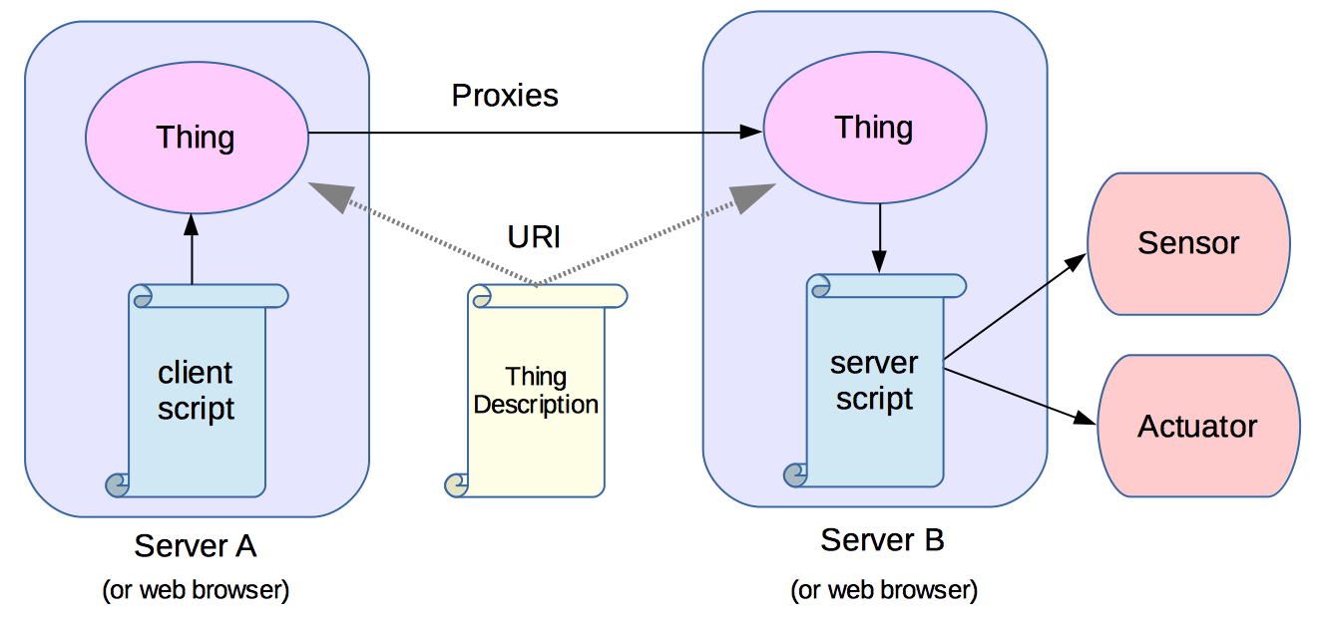
Distributed Web of Things
Thing descriptions can be used to create proxies for a thing, allowing scripts to interact with a local proxy for a remote entity
Scripts can run on servers or as part of Web pages in Web browser for human machine interface
Thing topologies
Peer to Peer, Peer to Peer via Cloud, Star, Device to Cloud, Star to Cloud
Proxy chains from the edge through the cloud to the browser

Slide 14






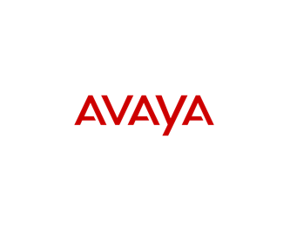










Members of the Web of Things Interest Group

Slide 15
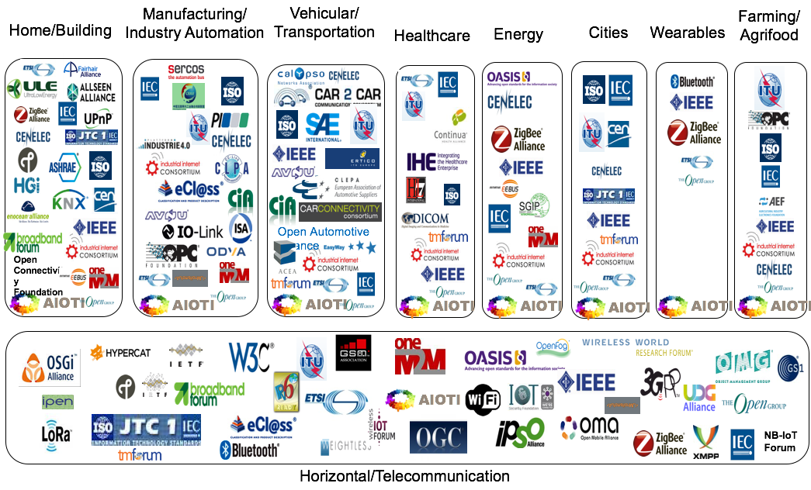
IoT Alliances and Standards Development Organisations
Source: AIOTI IoT Standardisation report release 2.6

Slide 16










Liaisons and Collaborations
Reaching out to industry alliances and SDO’s:
Plattform Industrie 4.0 (especially the “semantics” subgroup)
Proposed German Smart Home Initiative
Industrial Internet Consortium
OPC Foundation
IETF/IRTF
IoT-SF
BSI & Hypercat
oneM2M
GSMA
AIOTI
Open Geospatial Consortium (OGC)
OCF
AIOTI

Slide 17
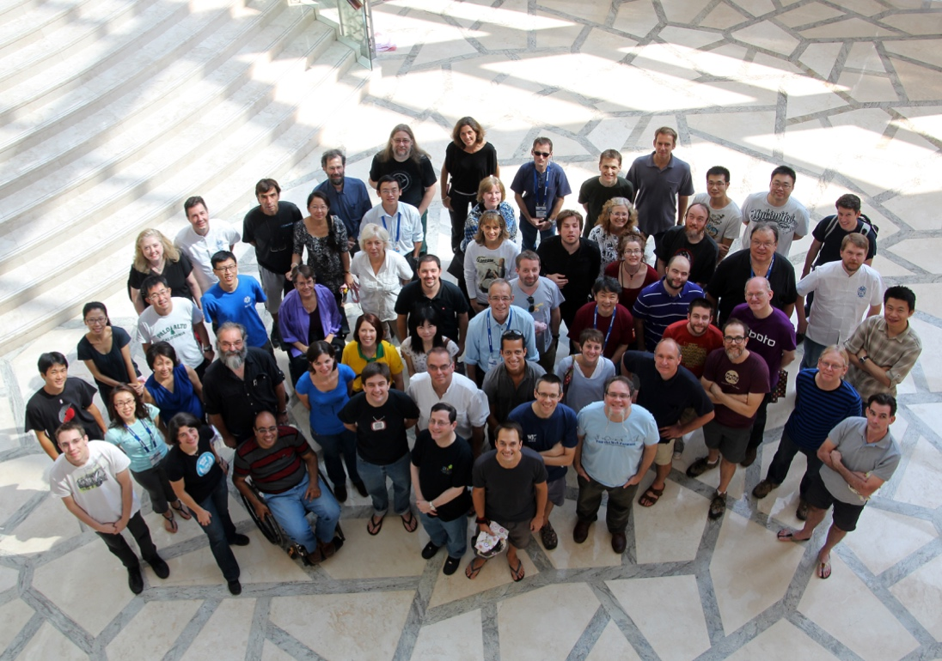
Work with us to build the Web of Things!
For more information on W3C see:
www.w3.org

